Slide 1
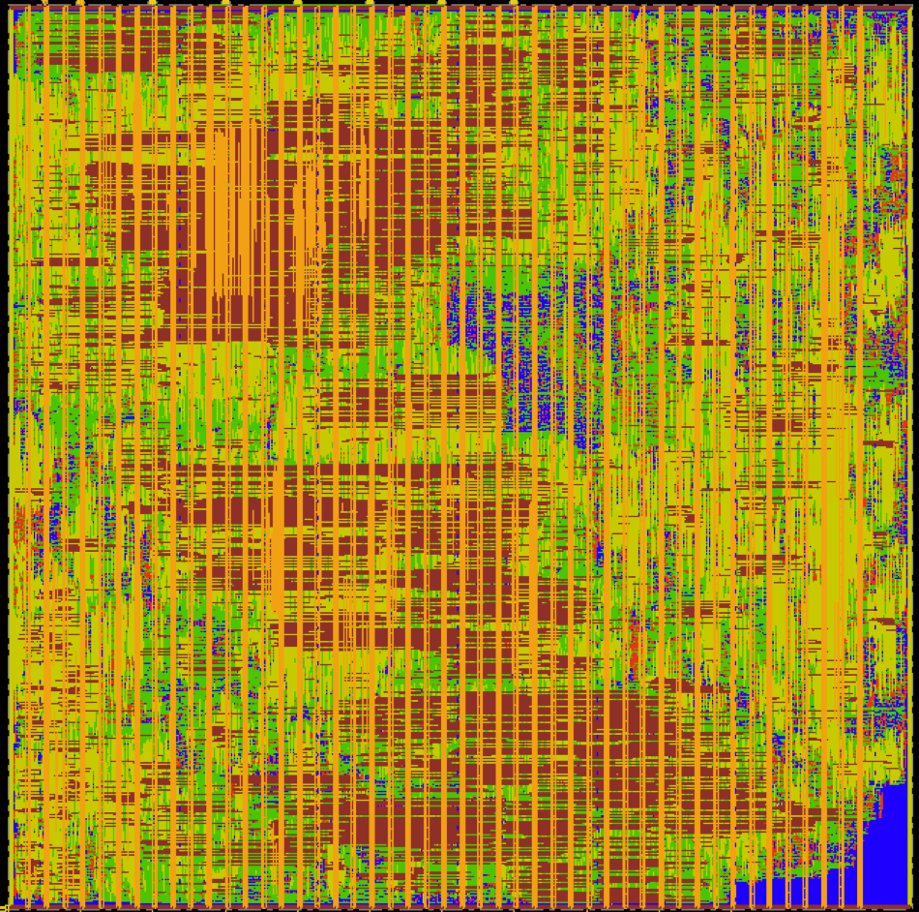
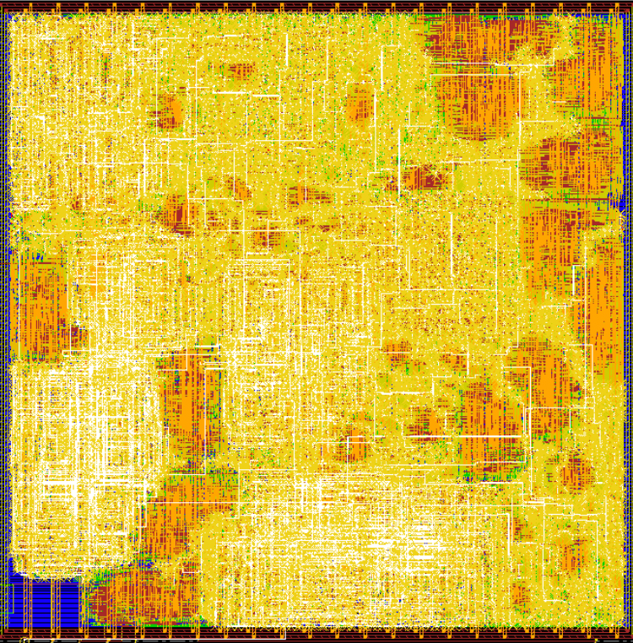
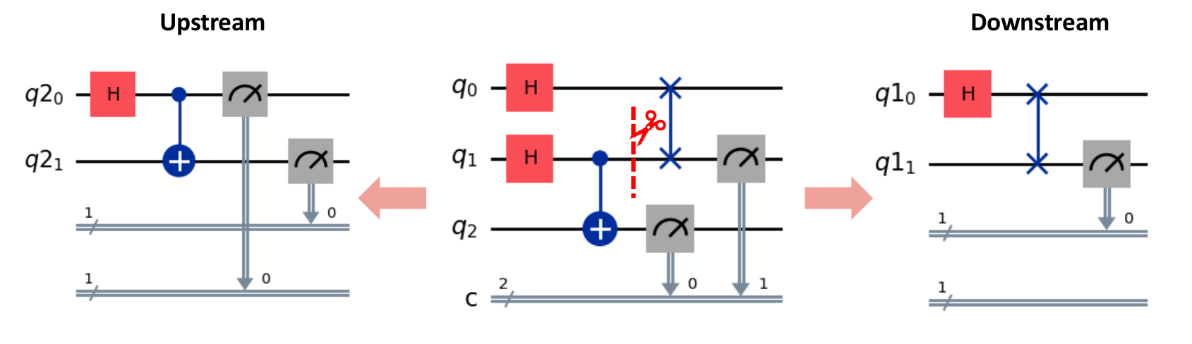
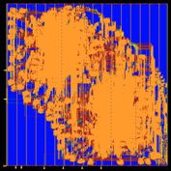
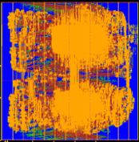




Scalable Quantum Circuit Simulation via Circuit Cutting [1-4] and Specialized Hardware Design Acceleration
Beyond Moore’s Law: Specialized ASIC Design Acceleration[5-8]
NSF #2216923.
NSF #2243981
Block GEMM Chiplet
+ Pointwise
TSMC 16nm
FFT Accel Chiplet
(any radix, size)
TSMC 16nm
TSQR RD I64O2
( 1 GHz, 277 GFLOPS)
TSMC 16nm
TSQR CS I32O2
(1 GHz, 576 GFLOPS)
TSMC 16nm
DOE LAB-24-3210
Accomplishment : Accelerator in 16nm TSMC outperforms NVIDIA H100 by 50x in raw performance/area and 50x in energy efficiency/flop [5-8]
Our Chiplet in 16nm TSMC Area eff.: 4.18 TF/mm²
Energy eff.: 4.8 TF/W
NVIDIA H100 in 4nm TSMC (10x denser than 16nm)
Area eff: 0.08 TF/mm²
Energy eff: 0.0957 TF/W
[1] US Patent
[2] ISQED’27
[3] QCE’26, [4] HPDC’26,
[5] OpenFPU IP [6] TCAD’27,
[7] FPGA’27, [8] HPEC’24
FFT Accel Chiplet
(any radix, size, nDim)
TSMC 16nm
Block GEMM Chiplet
+ Pointwise
TSMC 16nm

Slide 2

[1] CRC Press Book
[2] ToE’27
[3] ToE’21

Slide 3
Beyond Moore’s Law: Specialized ASIC Design Acceleration [4-6]
Our Chiplet in 16nm TSMC [7]
Area eff.: 4.18 TF/mm²
Energy eff.: 4.8 TF/W
NVIDIA H100 in 4nm TSMC (10x denser than 16nm)
Area eff: 0.08 TF/mm²
Energy eff: 0.0957 TF/W
FFT Accel Chiplet
(any radix, size)
TSMC 16nm
Accomplishment [7]: Demonstrated accelerator tile generator in 16nm TSMC that outperforms NVIDIA H100 by 50x in raw performance/area and 50x in energy efficiency/flop
Block GEMM Chiplet
+ Pointwise
TSMC 16nm
Our Chiplet in 16nm TSMC [7]
Area eff.: 4.18 TF/mm²
Energy eff.: 4.8 TF/W
NVIDIA H100 in 4nm TSMC (10x denser than 16nm)
Area eff: 0.08 TF/mm²
Energy eff: 0.0957 TF/W

Slide 4
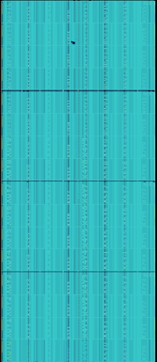
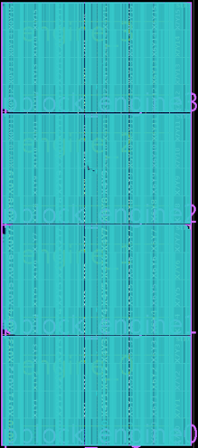
Classical-Quantum Circuit Design and Simulation
Xiaokun Yang, Professor, UH Clear-Lake | Affiliate Faculty, LBNL
Scalable Quantum Circuit Simulation via Circuit Cutting [1]
and Specialized Hardware Design Acceleration [2-3]
NSF #2216923.
NSF #2243981

